Slide 1
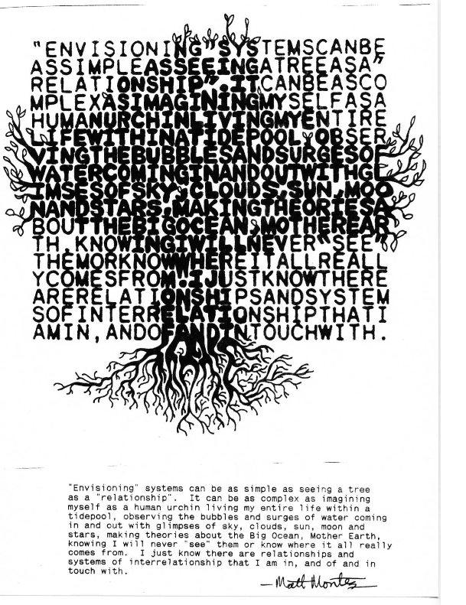
Systems Thinking

Slide 3
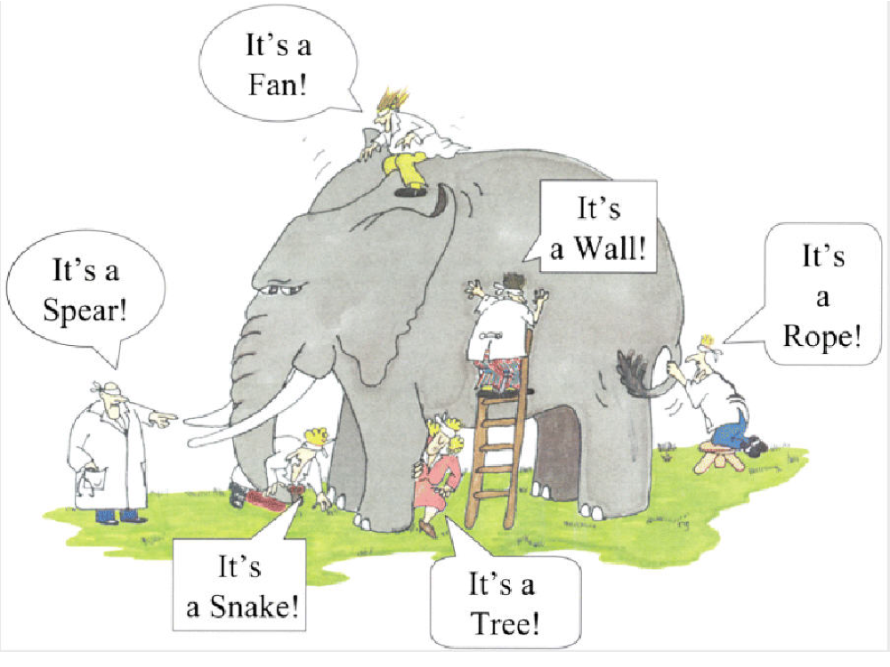

Slide 4
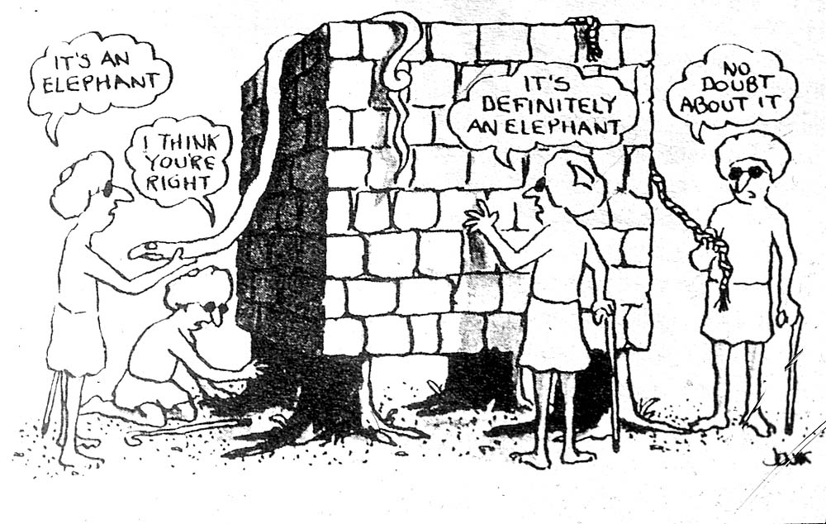

Slide 5
Defining “system”
Ecosystem
Digestive system
Production system
Computer system

Slide 6
Set vs. System
System
Structured Set
Set

Slide 7
System - defined
“A set of two or more interrelated elements with the following properties:
1. Each element has an effect on the functioning of the whole.
2. Each element is affected by at least one other element
in the system.
3. All possible subgroups of elements also have
the first two properties.”
(Ackoff, Russell L. Creating the corporate future: Plan or be planned for. New York: Wiley, 1981. Pp. 15-16.)
In short, a whole made up of interdependent components in interaction is identified as a system.
“A system is less a thing than a pattern”
– Joanna Macy

Slide 8
Taxonomy of systems according to Checkland
Type of systems
Natural systems
Designed physical systems
Designed abstract systems
Human activity systems
Transcendental systems
Examples
Atoms, planet Earth, animals, galactic systems
Hammers, trains, space ships, sculptures
Mathematics, poetry, philosophy
Orchestra, international political system
God, spirit/soul, paradise

Slide 9
Taxonomy of systems according to Boulding
Type of systems
Static structure
Symple dynamic system
Control mechanism or cybernetic system
Open systems
Genetic-societal systems
Animal system
Human system
Social system
Transcendental systems
Examples
Framework
Mechanical clock
Thermostat
Cell
Plant
Dog
Human being
Family
God

Slide 10
What is Systems Thinking?
Analysis
Synthesis
Structure (identification of components)
Function (identification of role)
Analysis
Synthesis
Knowledge (answers to “how to” & “what” questions)
Understanding (answers to “why” questions)
∴
in order to both know and understand
our environment, we must use
analysis and synthesis
analysis + synthesis = Systems Thinking

Slide 11
Systemic
Enlightenment
Reaches new
planes of
- is transcendent
consciousness
Wisdom
Requires
- is valuative
empathy
and is
normative
Understanding
Answers to ...
- why?
Limits of
- is explanatory
... type questions
Limits of
Teaching
Teaching
Knowledge
- is instructive
Answers to ...
- how?
- how to?
... type questions
Information
- is descriptive
Answers to ...
- who?
- what?
- when?
- where?
Data
- how many?
... type questions
Elements of
information
without context
Reductionistic
"factoids"

Slide 12
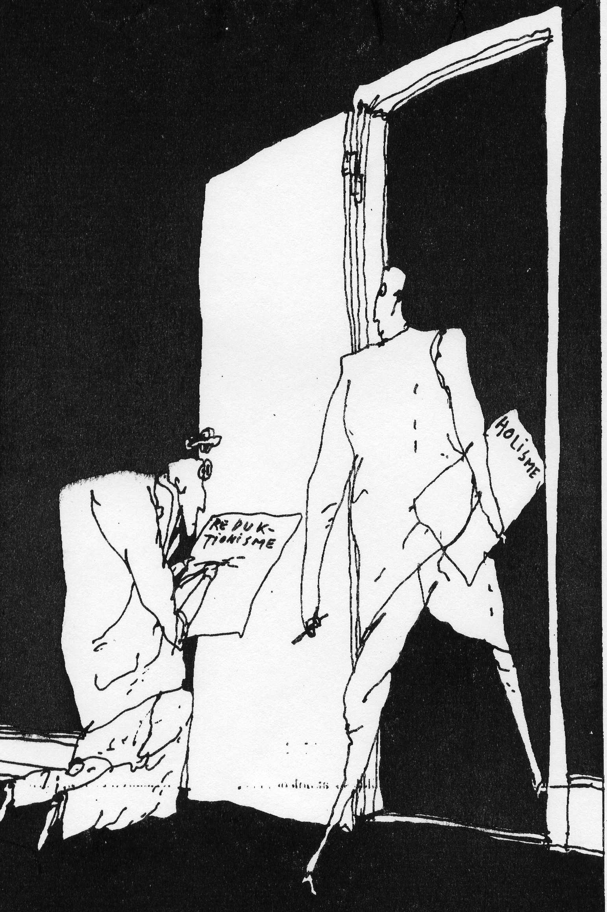

Slide 13
General System Theory Allgemeine Systemtheorie
What is:
“A theory, not of systems of a more or less special kind, but of universal principles applying to systems in general”
Von Bertalanffy, 1968
The point is that there is a kind of theory known as system theory, and there is a general form of this theory: general system theory

Slide 14
General System Theory
What it is not:
A theory that relates to several entities called systems
A theory of an entity called general system
Theorie der algemeinene Systeme

Slide 15
The Three Cultures

Slide 16
Relative interpretive power of two frameworks for sociocultural change

Slide 17
Systemic Possibilities
nature of the relationship between participants
unitary
pluralist
coercive
mechanical
Hard Systems
Thinking
Soft Systems Thinking
Emancipatory
Systems
Thinking
nature of the system
Organizations as
Systems
Organizational
Cybernetics
systemic
Critical Systems Thinking

Slide 18
Four paradigms for the analysis of sociological approaches

Slide 19
Types of scientific inquiry based on Jung’s personality types

Slide 20
Clusters of scientific approaches
Paradigms and types of scientific inquiry
functionalist + analytical scientist
radical structuralist + conceptual theorist
radical humanist + conceptual humanist
interpretative + particular humanist
New clusters of scientific approaches
 Natural Scientist
 General Theorist
 Human Scientist
 Particular Humanist

Slide 21
Methods appropriate for types of inquiry

Slide 22
Describing an orange

Slide 23
Three Systems Models
Environment Model
Describing the system in its natural and social context
“Birds-eye view” of the system
Function/Structure model
Describing the actions of the system, the parts that carry out these actions, and their relationships
“Snap shot” of the system
Process Model
Describing the system in movement, over time, in interaction with its parts and with the environment
“Moving picture” of the system

Slide 24
Example of the Systems Models
What is a
Human?
From a socio-cultural and ecological perspective
From a biological perspective
From an evolutionary and developmental perspective
Environment Model
Structure/Function Model
Process Model

Slide 25
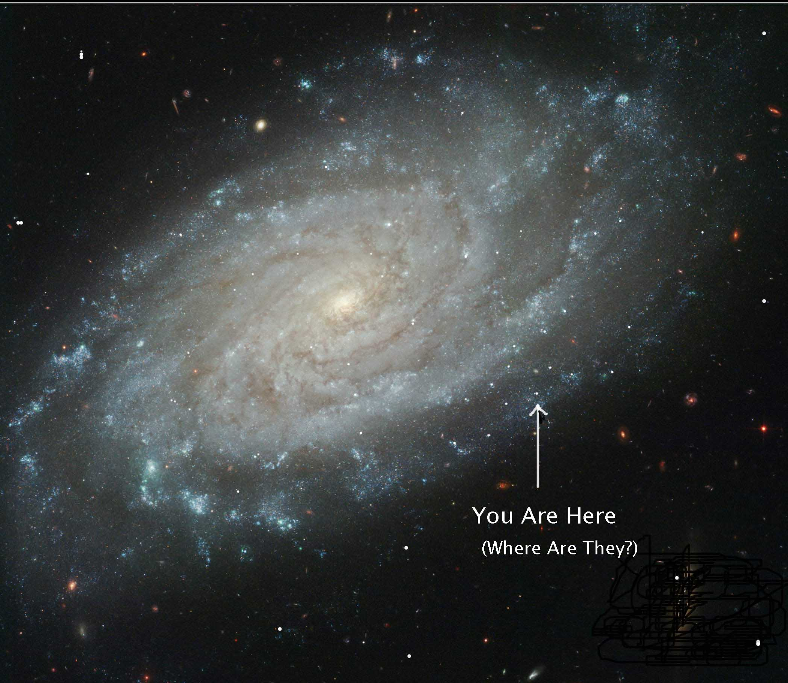

Slide 26
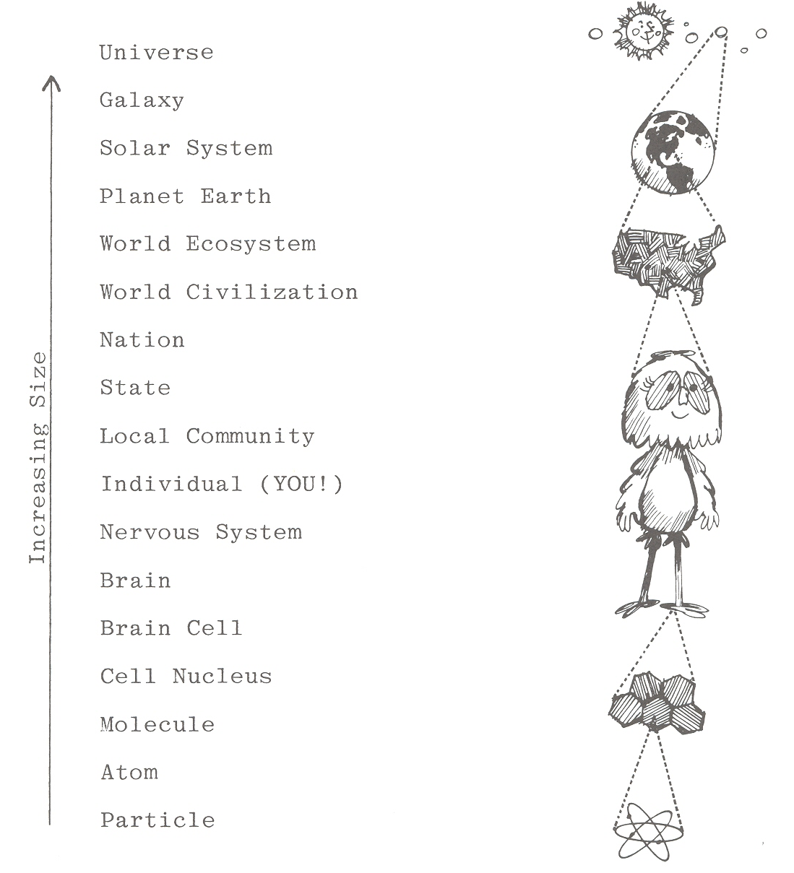
Systems
include
other
systems…
…and
are
part
of
other
systems

Slide 27
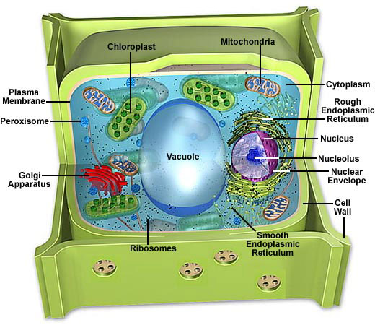
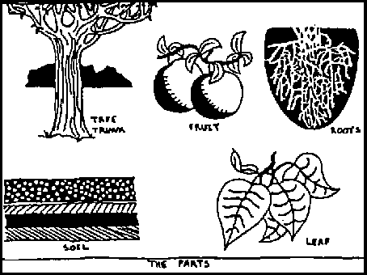

Slide 28
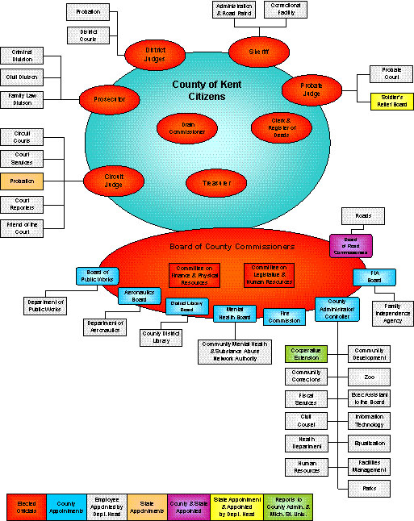
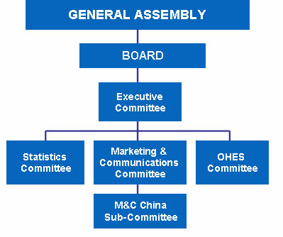
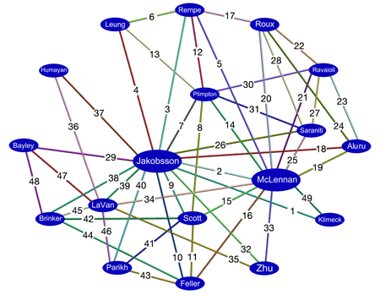

Slide 29
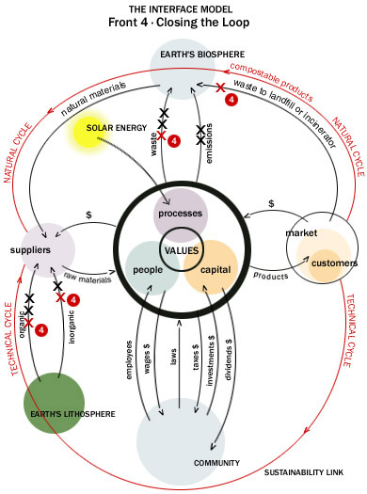

Slide 30
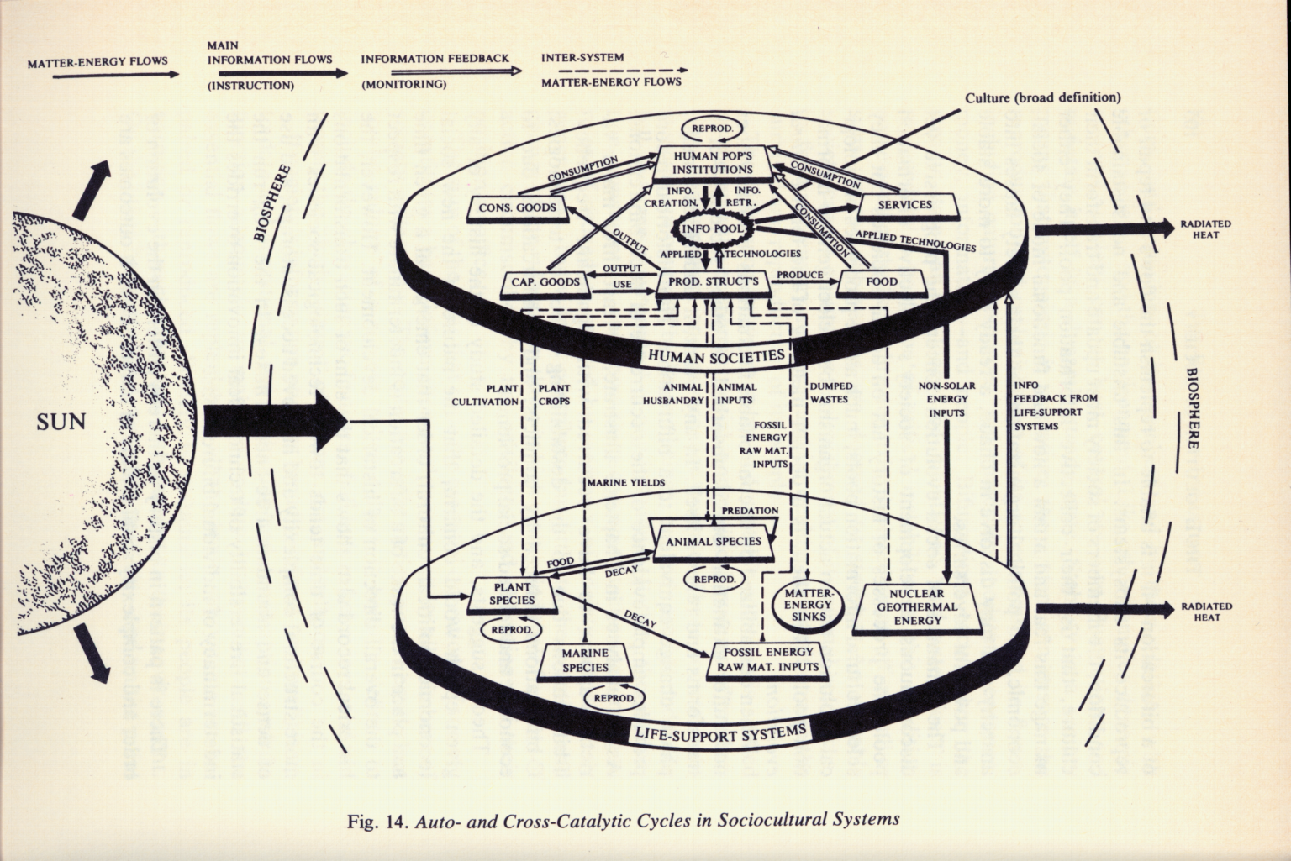
The biosphere is a single dynamic living system with both human societies and embedding life-support systems fueled by the sun
Source: E. Laszlo, Evolution, 1987

Slide 31
“BOIDS!”
Notes:
Short video on “bird-droids” (boyds) demonstrates a fuzzy logic program for a dynamic virtual reality environment in which twenty “boyds” demonstrated self-organizing flocking behavior based on three simple rules:
all boyds must be in constant forward motion
no boyd can touch any other object (stationary or moving)
all boyds must seek to be at the center of all other moving objects
Example used to illustrate “fuzzy guiding rules” used to generate complex adaptive behavior without having to rely on complicated algorithms.

Slide 32
MindWalk

