Slide 1
Leadership for Civilizational Trajectory Change
THE Strategic Challenge
Of the 21st Century
Effective Learning in an Age of Increasing Speed, Complexity and Uncertainty
2nd International Conference on Future Education
World Academy of Art and Science
World University Consortium
Roma Tre University
Rome, Italy
November 16 – 18, 2017
Ruben Nelson
Foresight Canada

Slide 2
My Thesis
NEED: a new type of leadership and a new institutional support system for it.
NEW WORK: nurture into robustness both the next level of human personal/cultural maturity and the next form of human civilization while there is time.
THIS AGENDA: underlies/surrounds all else.
WE ARE AT RISK: this agenda is not on the table.
THERE IS HOPE: the other side of despair and depression.

Slide 3
Forms of Civilization to Date
Modern/Industrial
Degree of living complexity that can be lived with.
Regional Empires
Local Settled Agriculture
Small Group Nomadic
-200,000 -10,000 -5,500 -1000 2017 2300
Time
Not to scale.

Slide 4
Official M/I Expectations
Modern/Industrial
Degree of living complexity that can be lived with.
Regional Empires
Local Settled Agriculture
Small Group Nomadic
-200,000 -10,000 -5,500 -1000 2017 2300
Time
Not to scale.

Slide 5
Futures Now Programmed In
Modern/Industrial
Degree of living complexity that can be lived with.
Regional Empires
Local Settled Agriculture
Small Group Nomadic
-200,000 -10,000 -5,500 -1000 2017 2300
Time
Not to scale.

Slide 6
Our Promising Future
“Global Eco-Personal cultures”
Co-creative
Modern/Industrial
Degree of living complexity that can be lived with.
Regional Empires
Local Settled Agriculture
Small Group Nomadic
-200,000 -10,000 -5,500 -1000 2017 2300
Time
Not to scale.

Slide 7
M/I in a Long Disintegration
X
Coherence
Modern/Industrial
Time

Slide 8
Seneca Cliff
X
Coherence
Modern/Industrial
Time

Slide 9
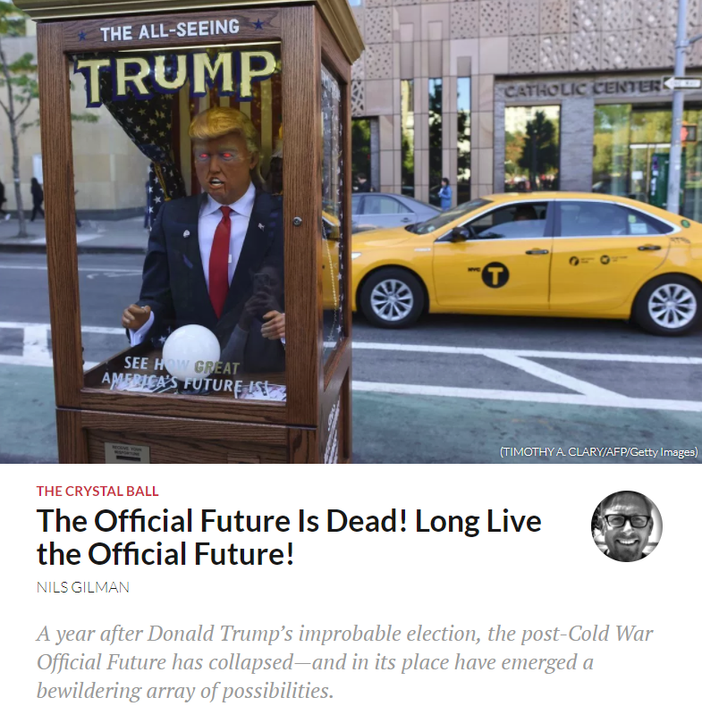
A Black Elephant In Our Room

Slide 10
Our Hope
Coherence
Modern/Industrial
Co-Creative
Time

Slide 11
A Century of Bridging Strategies
Coherence
Modern/Industrial
Co-Creative
Time

Slide 12
Leadership for Civilizational Trajectory Change
1. Leadership Unprecedented Conditions
Previous CTCs
Long/Slow
Optional
Local/Regional
Unintentional
Exclusive
Our CTC
Short/Fast
Required
Scalable to all
Fully Intentional
Inclusive

Slide 13
Leadership for Civilizational Trajectory Change
2. Beyond the fragmentations of the 1st Enlightenment
“I have spent much of the last forty years endeavouring to understand world views other than those we in the West have inherited; and in the last several years I have been particularly concerned with the question of what is involved in the endeavour to understand, and to help others understand, an outlook different from the one that one already has.
One of the conclusions to which I have come is that in order to understand a different view – especially if it be radically different and/or profound, comprehensive, humane – one must oneself become a different sort of person.”
Wilfred Cantwell Smith

Slide 14
Leadership for Civilizational Trajectory Change
3. Beyond the influence of our M/I form of Civilization
Greenfield project.
Embody corporate integral and reflexive wisdom.
Research and practise in CTC at every scale and time frame.
Train future researchers-practitioners.
Identify, connect with, nurture all who “warm” to the work.
Networked with similar bodies globally.
$25m minimum budget each node of the network
Design and launch a “Manhattan-type” project by 2025.

Slide 15
Inspiration
The biggest things are always the easiest to do because there is no competition.
William van Horne
Canadian Industrialist
1843-1915

Slide 16
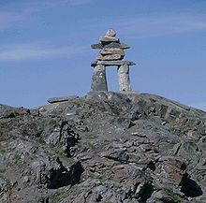
Over to YOU!
Our Future is in Your Hands, Minds and Hearts
Thank you

Slide 17
Contact Information
Ruben Nelson
Executive Director
Foresight Canada
29 des Arcs Road
Lac Des Arcs, AB, Canada
T1W 2W3
RubenNelson@shaw.ca
+1-403-673-3537 = voice
+1-403-673-2114 = fax
www.foresightcanada.com

